Slide 1
Game Analytics Slides adapted from WG on Game Analytics in Dagstuhl seminar on Integration in C&AI in Games
Christian Bauckhage, Bruno Bouzy, Peter Cowling, Graham Kendall, Pier Luca Lanzi, Simon Lucas, Mark Winands

Slide 2
What?
Learning from human game play
Learning from self-play
Analyzing the game (rules, game tree)
Understanding player behaviors (player / experience modelling)

Slide 3
Why?
Improving playing experience
Develop metric (e.g. for skills)
Finding problem in design / goldfarmers exploits
Automization of bot programming
Game balancing

Slide 4
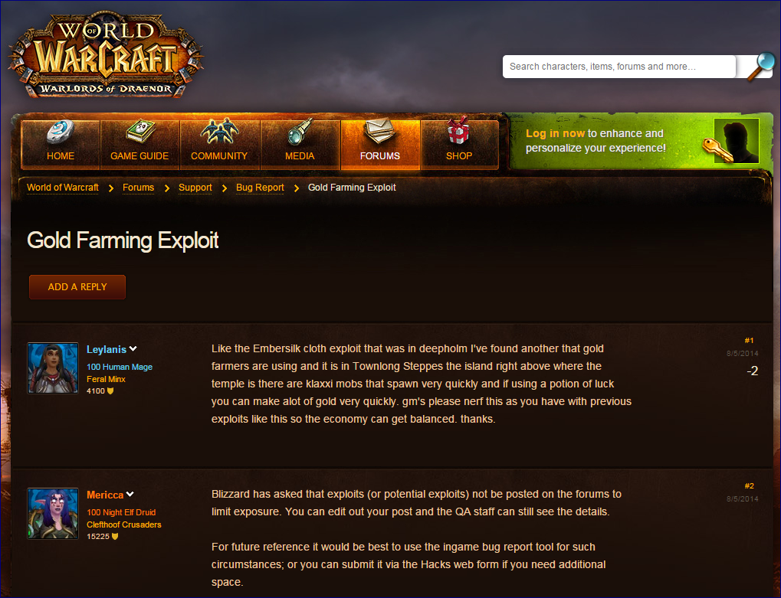

Slide 5
Mapping the field
Features/measurements | Methods | Derived measures
Duration/interval times Number of players Seesaw Dominated action (im)perfect information Tactics Strategy Dexterity | Basic statistics ELO like measures Cluster Analysis Neural Network Game Tree analysis Questionnaire A/B testing | Imbalance Skill depth Frustration Addiction level Aesthetics

Slide 6
Industry Goal / Objective
Maximize revenue
Maximize retention
Maximize # premium players
Maximize fairness / balance
Maximize player enjoyment

Slide 7
Academic Goals / Objectives
Data
Understand behaviour
Therapy
Human like behaviour
Better bots
Behaviour psychology
Max fairness / balance
Map layout
Gamefication
Scientific problems (e.g. protein folding, economics, politics, education)

Slide 8
Case Studies
 | Planet Wars vs pw++ (RTS) | Resistance (+ chat ) (Card) | Retry? (Casual) | Skiddy (Puzzle)
Raw game log | Sequence of Planet Pairs Map data, initial conditions, sequence of game states (*) | Choose master Choose team, ?chat? Execute mission, announce results Identities, “likes” Chat: when what | Sequence of touch events (where duration is important) {t1, d1}, {t2. d2}, … Game Map | Sequence of move achievements
Derived Game Log | Sequence of feature vectors Comparison with optimal moves (is this player any good?) Could be local subgame Extract features (*) | Correct votes, games won, team logs, chat accuracy, id | Sequence of Position Velocity Pairs Orientation of plane, proximity to the walls, landing strip | Position of the tiles. distribution of moves, Comparison with optimal moves
Difference analytics | Focus on effect of the variation -> collision rate | Chat on vs of ?do they chat? | Map, analyse proximity, progress, change ship physics, wind weather | Change of levels & mechanics, effect on the difficulty
Bot skill analysis | Analyse tournament results -> Does the rank order change? | Ok | Analyse score progress distribution for different skills of bots | Skill rating of the bots Effects of different heuristics on the search difficulty

Slide 9
Questions for Analytics to Answer
We made a change:
Can the difference be detected?
Hole detection / exploits?
Entropy changes?
More drama? (e.g. more flux in obvious measures?)
Can we learn a new strategy? And make better bots?
Can GUI frustration be measured?
Analysed touch events, near misses?
Bot Id Detection?

Slide 10
Integration: Deep NNs
The type of analysis you might do when Deep NNs become more mainstream:
Social Affect Analysis
From face / body language Voice.
Kinect / Front Camera

Slide 11
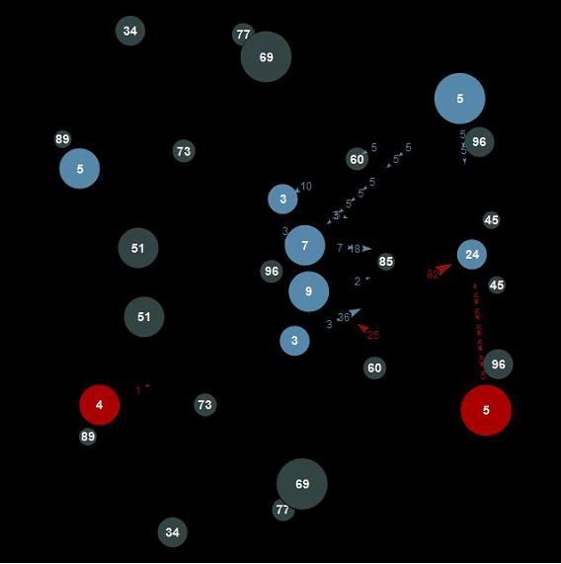
Planet Wars Data Analysis: Plotting “Piece” Difference

Slide 12
Exercise
In groups:
Develop a set of measures to apply to “Space Battle”
Implement some of them (aim for simple and effective)
Test their ability to detect differences in the game setup, and in the agents playing the game
See PacMan CIG 2012 paper for example of spatial analysis – a version of this might be useful for Space Battle

